Slide 1
Develop an IoT dashboard for real-time energy monitoring and automation using LoRa communication
Presented by: Sanjay Prathmanyu S Pravinchander S L
InnoVentures (7376241EE184) Ranjithkumar L
Sathana V T Selvaraj kumar S M
(7376241EE187) Abileshkaleeshwar K

Slide 2
Objective :
Track energy consumption in real-time for better decision-making
Automate data collection to reduce human error and increase accuracy
Increase awareness of energy use among consumers and organizations
Optimize energy consumption through insights and data analysis
Provide cost predictions and help manage energy bills
Monitor power quality to ensure a stable electricity supply
Send alerts and notifications to prevent wastage or system failures

Slide 3
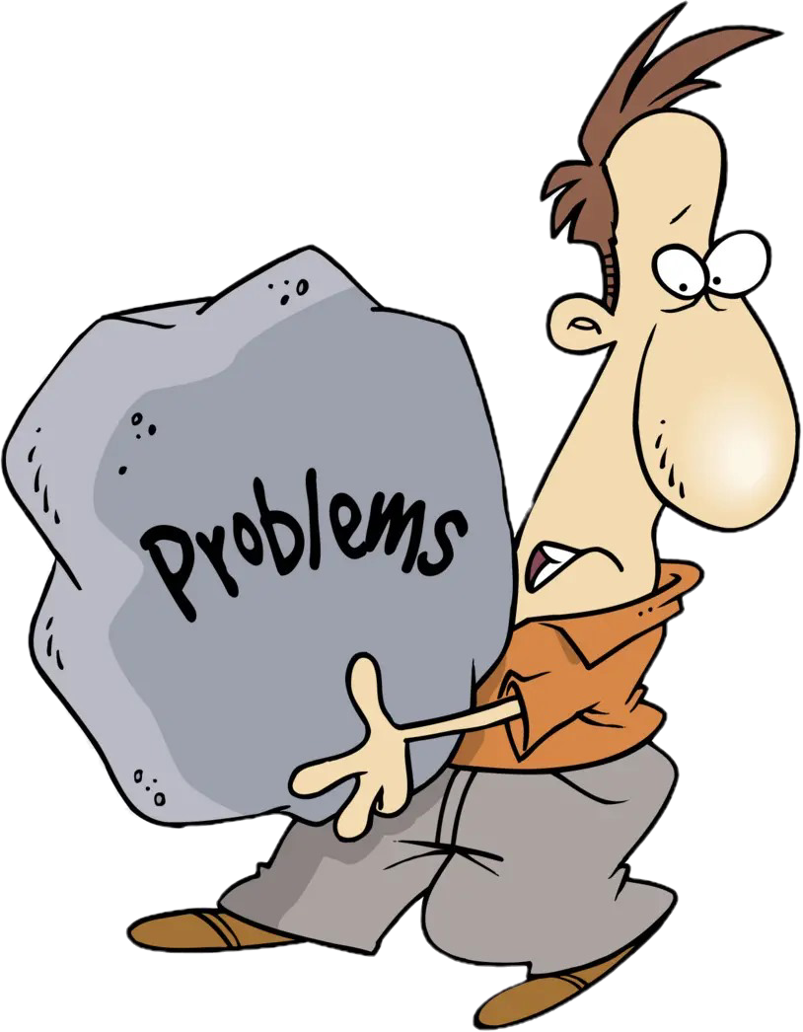
Problem Identified

Slide 4
Consumers often face high electricity bills due to lack of real-time visibility into their energy usage, relying instead on monthly or bi-monthly bills that offer minimal actionable insights
Currently, in many areas, electricity meters are read manually by field workers (EB man), which can lead to errors, delays, and sometimes even fraud (e.g., incorrect reading, intentional tampering)
Many consumers unknowingly waste energy by leaving appliances running unnecessarily or using electricity inefficiently. This leads to higher costs and an increased carbon footprint

Slide 5

Proposed method

Slide 6
The proposed solution offers consumers real-time energy consumption tracking, allowing them to monitor their usage continuously. This enables identification of high-consumption periods or wasteful appliances, facilitating immediate corrective action to reduce energy costs
By automating energy data collection through smart meters and sensors, your system eliminates human error, provides accurate readings, and enables real-time data transmission, ensuring more reliable and precise billing
Our system helps consumers become more aware of their consumption patterns, allowing them to optimize energy use, reduce wastage, and lower electricity costs. Alerts and suggestions based on real-time data can prompt users to take energy-saving actions

Slide 7
BLOCK DIAGRAM

Slide 8
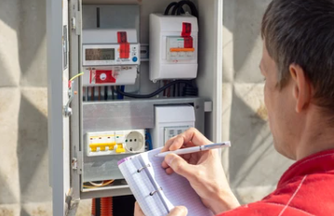
Existing method

Slide 9
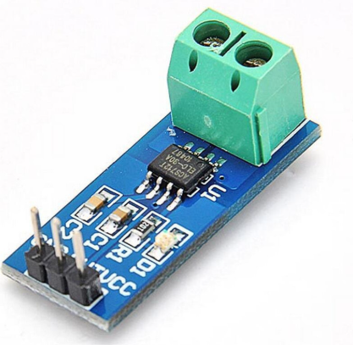
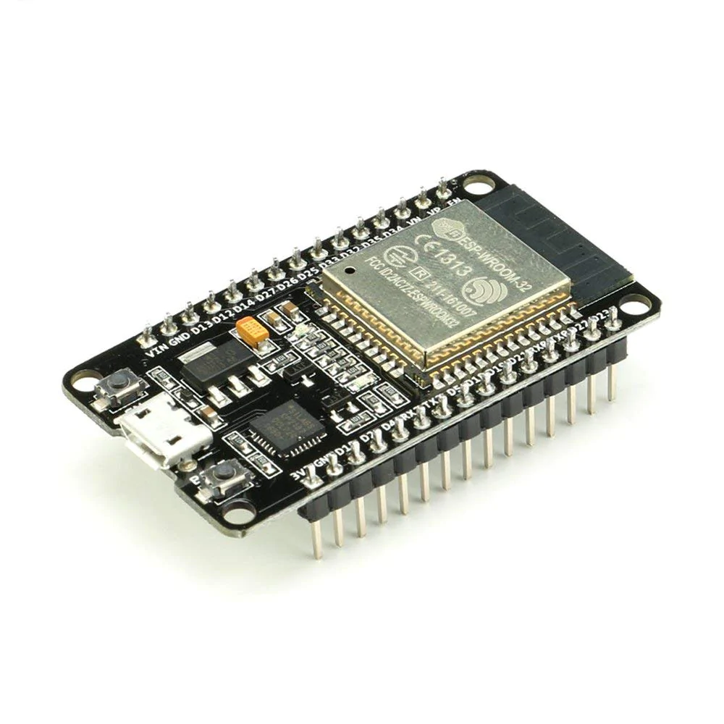
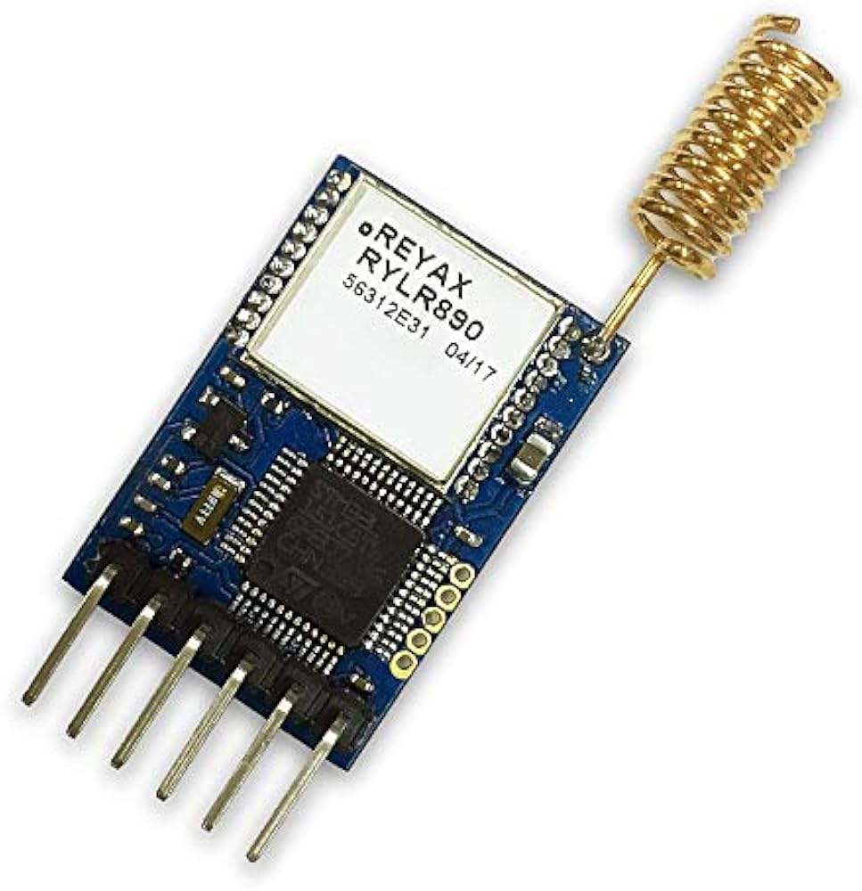

Proposed method
Current sensor ESP32 LoRa Module(house1)
Data Base ESP32 LoRa Module(main)

Slide 10


(Slave1)
ESP32+LoRa+Relay module+sensor
(Master)
(Slave2) ESP32+LoRa+GSM
ESP32+LoRa+Relay module+sensor
DATA BASE

Slide 11
COMPONENTS

Slide 12
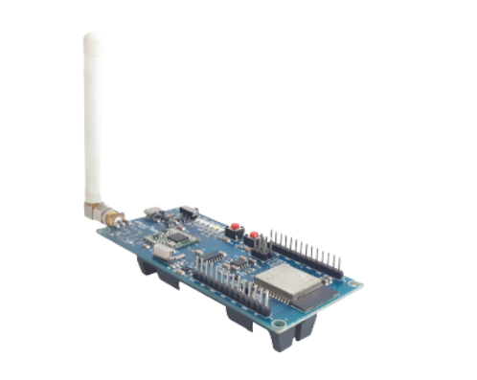
ETS IoT®-WDM Ver 2.0
Long-range: Covers kilometers, ideal for wide-area IoT
Bidirectional: Supports two-way communication
Secure: Built-in encryption for data protection
Integrated Wi-Fi and Bluetooth: Enables
wireless connectivity
Dual-core processor: Handles multiple tasks efficiently
The ESP32 is a fast microcontroller with a speed of 240 MHz

Slide 13
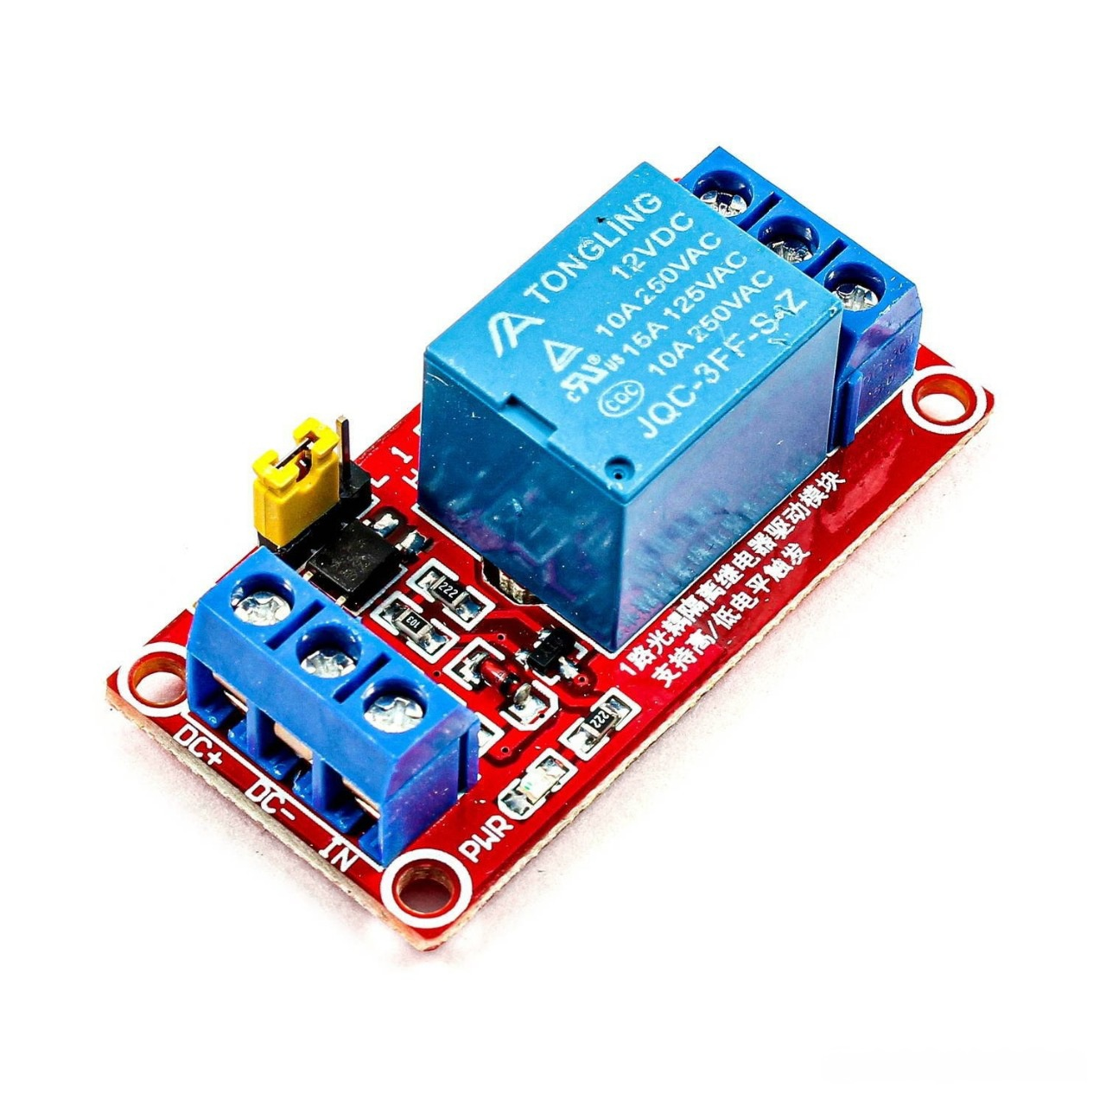
Relay:
Switching: Opens and closes circuits to control current flow
Isolation: Separates control circuit from the high-power circuit
Amplification: Allows low-power signals to control high-power loads

Slide 14
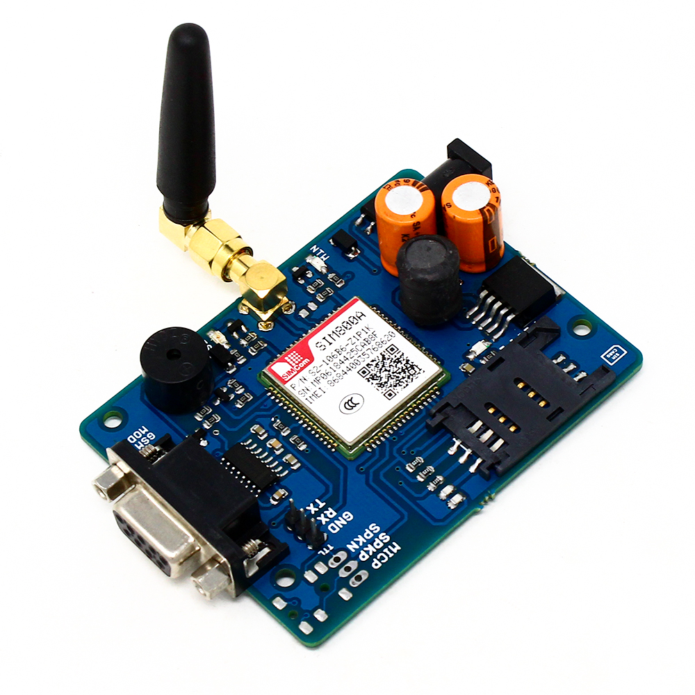
GSM(Global System for Mobile Communication):
Connectivity: Enables devices to communicate over the GSM cellular network
Functionality: Supports data communication (GPRS/EDGE), SMS messaging, and sometimes voice calls
Interface: Typically communicates with other devices via serial interfaces (UART)

Slide 15
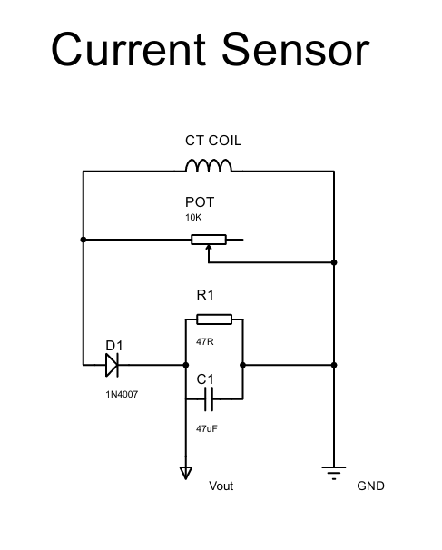

Slide 16
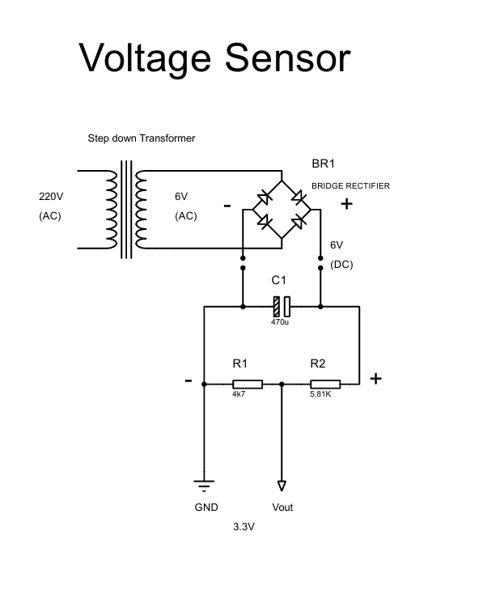

Slide 17

Coding

Slide 18
Slave code:

Slide 19
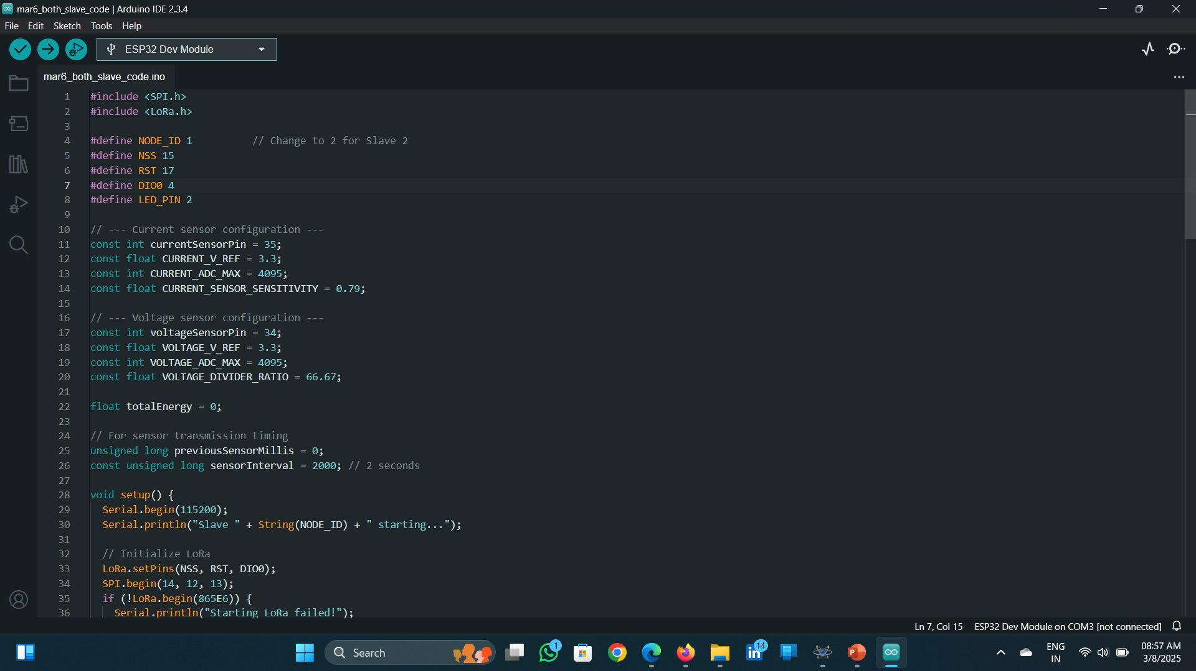
Slave code:

Slide 20
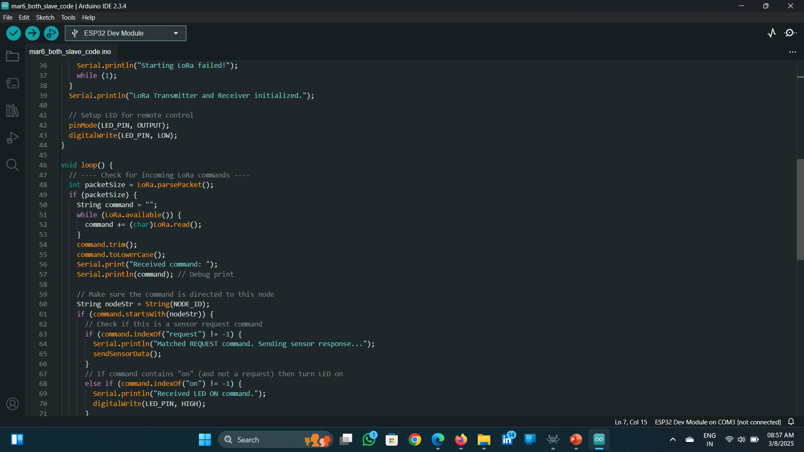

Slide 21
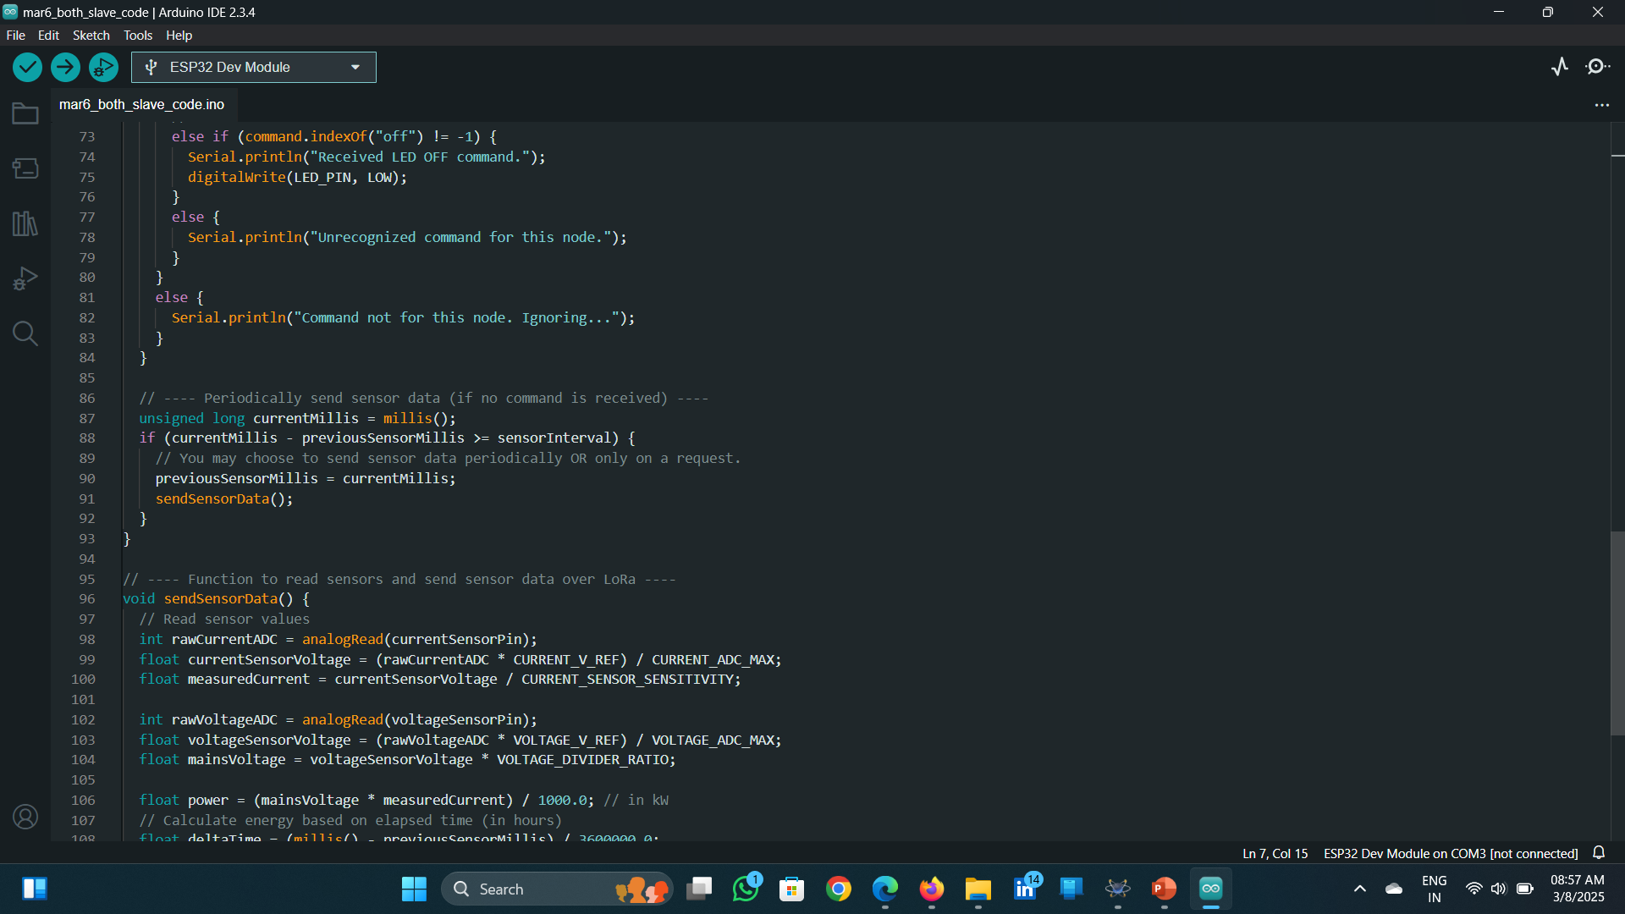

Slide 22
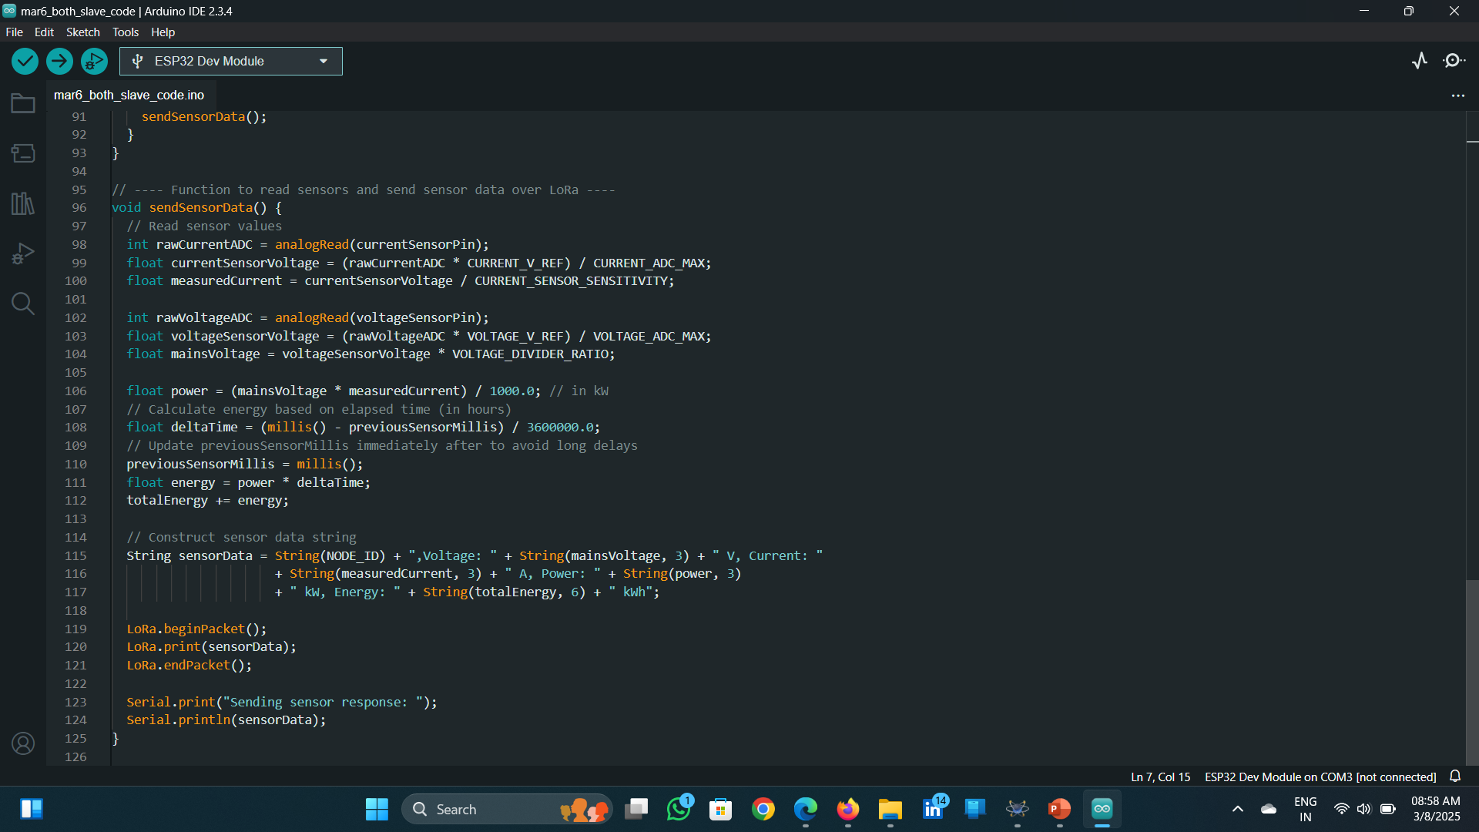

Slide 23
Master code:

Slide 24
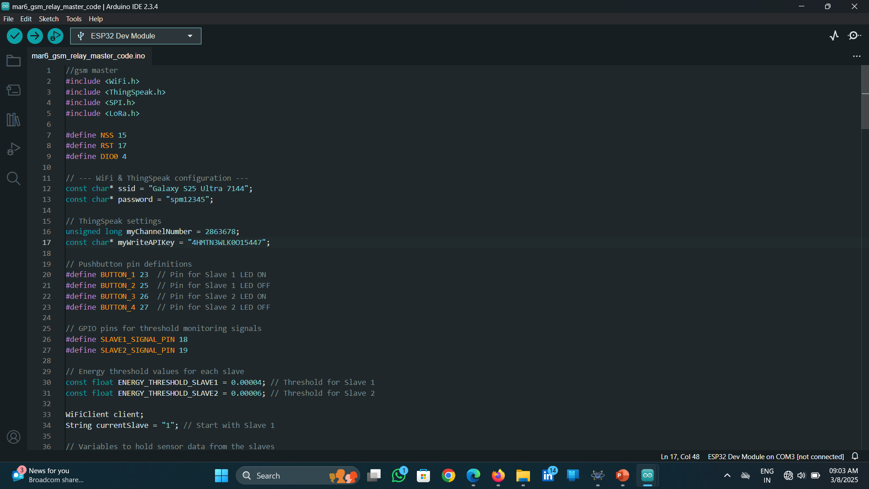

Slide 25
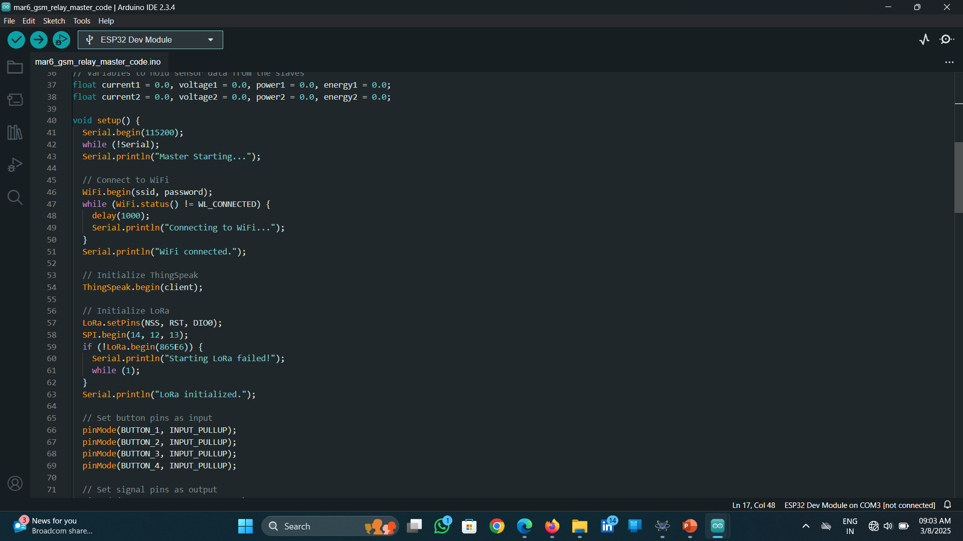

Slide 26
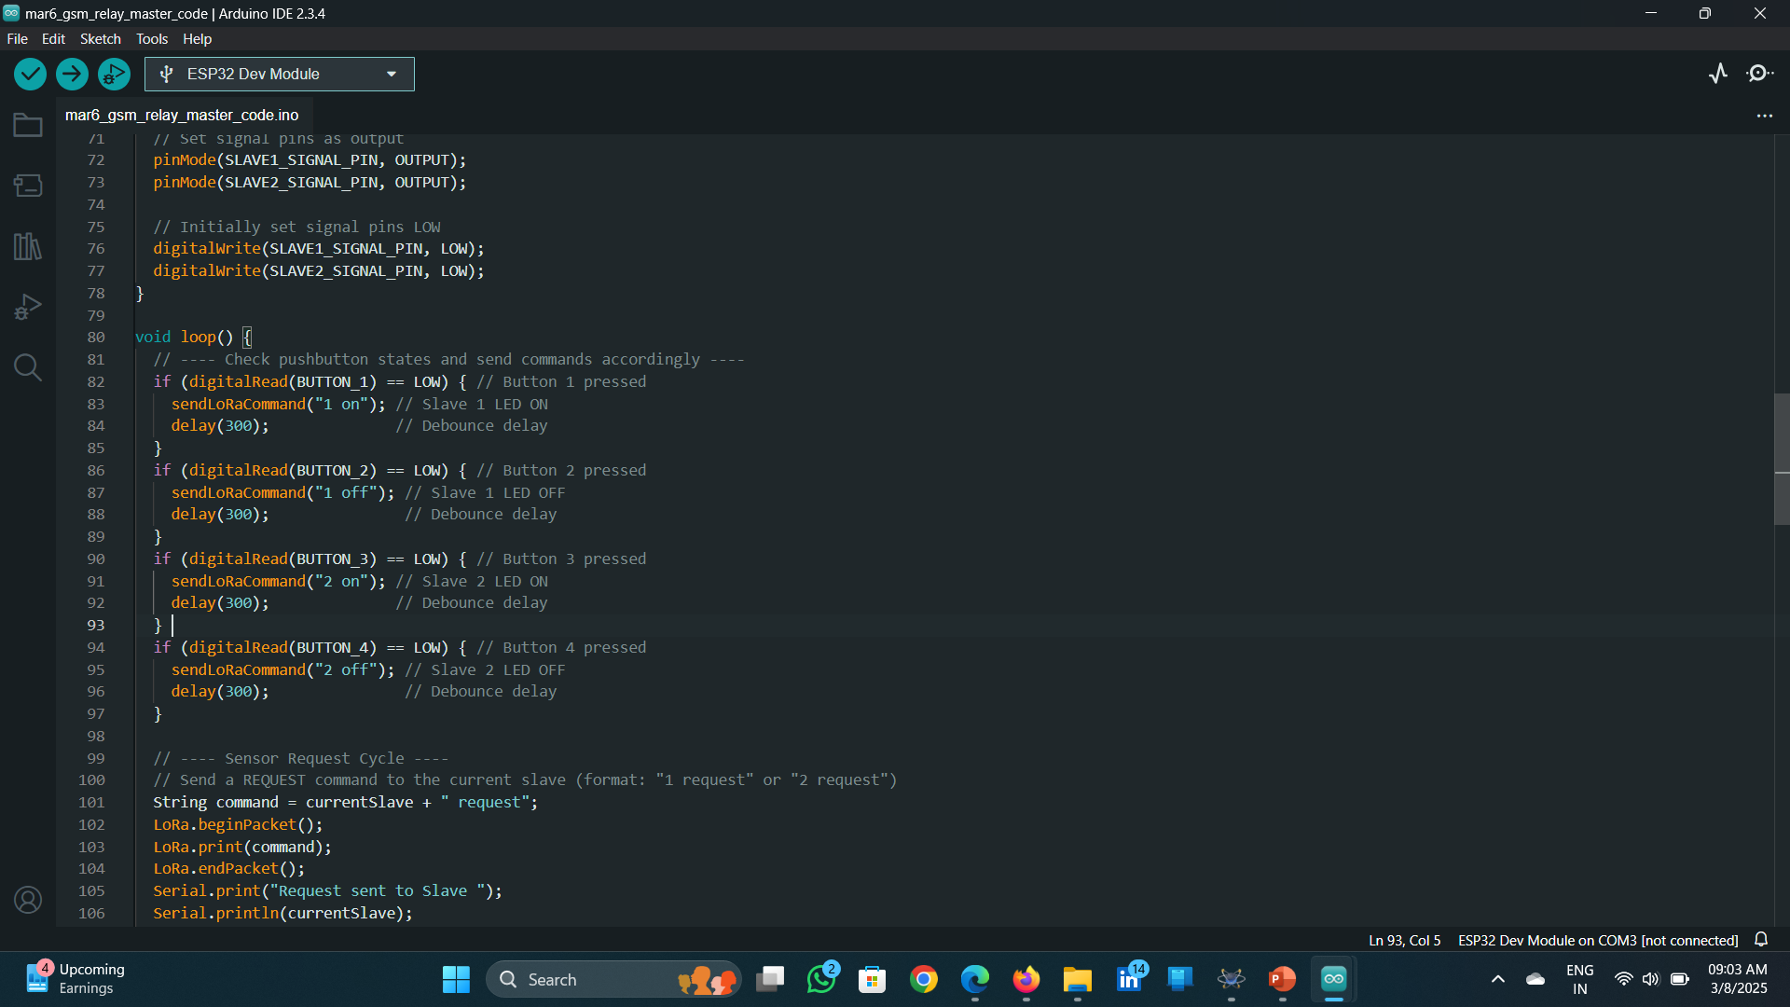

Slide 27
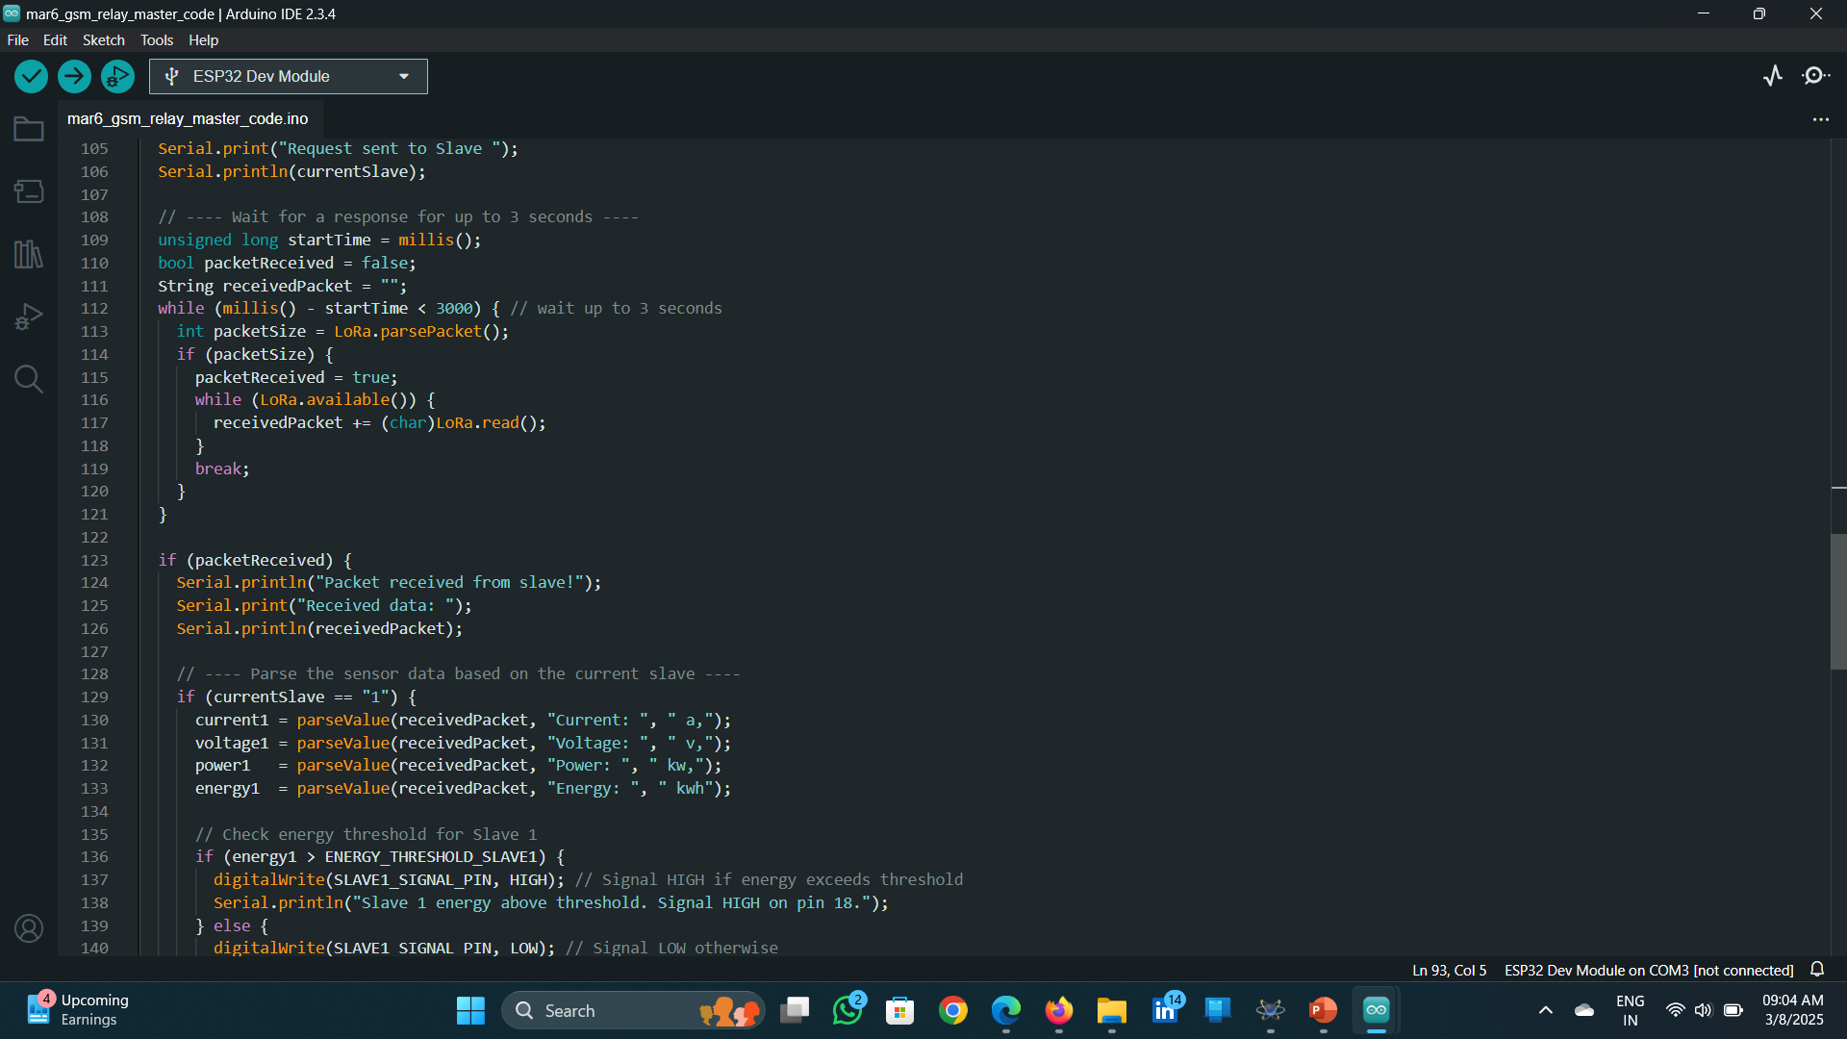

Slide 28
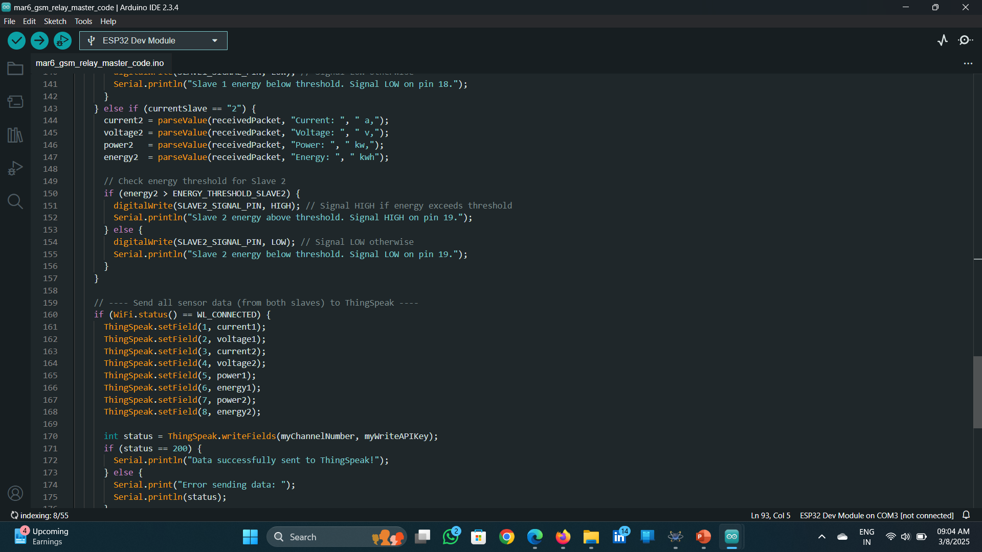

Slide 29
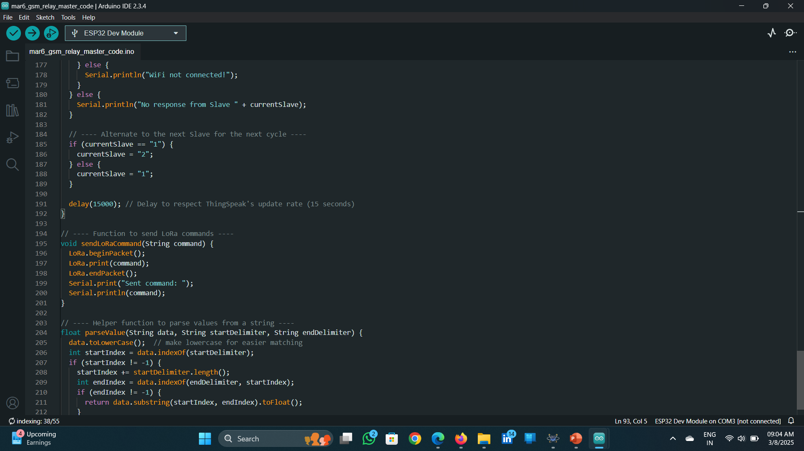

Slide 30
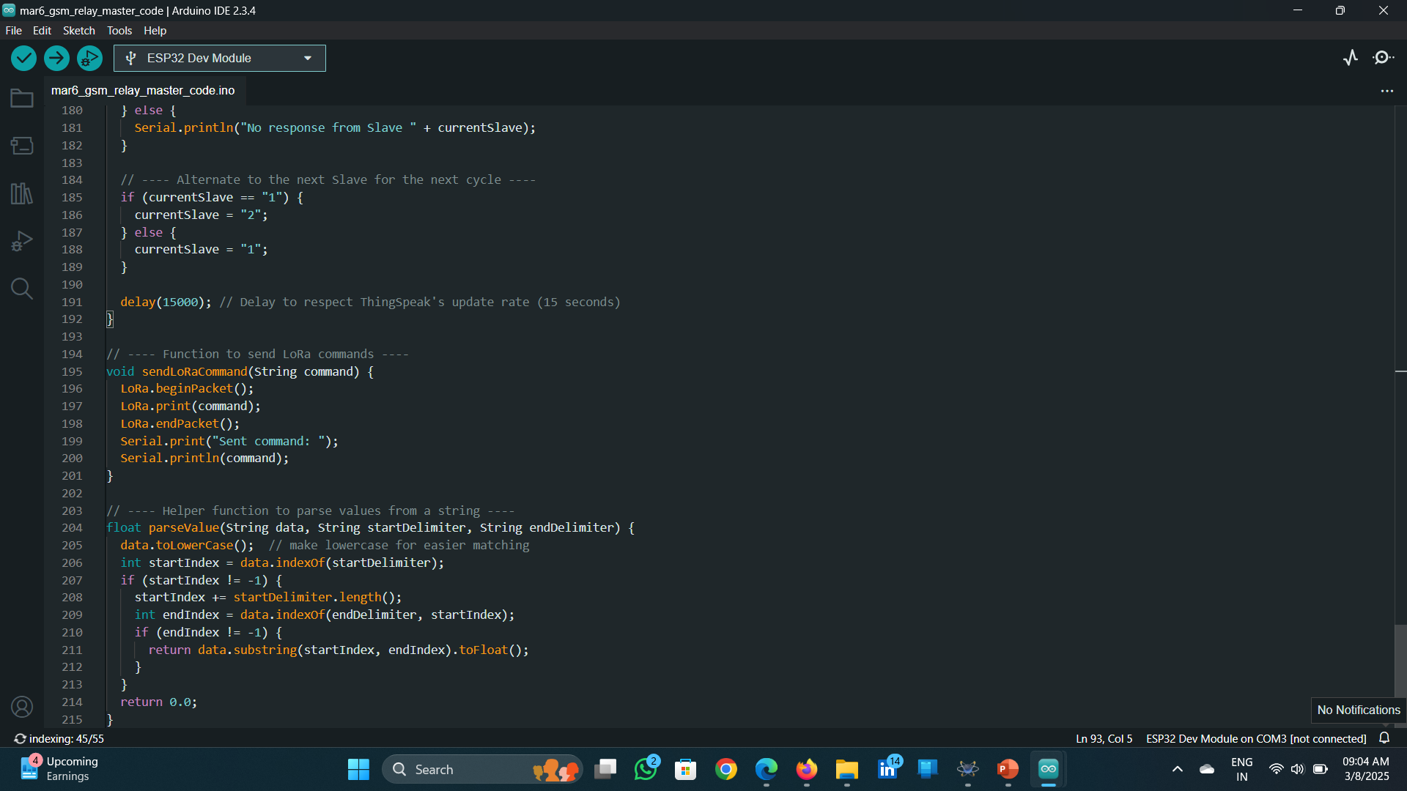

Slide 31
Gsm code:

Slide 32
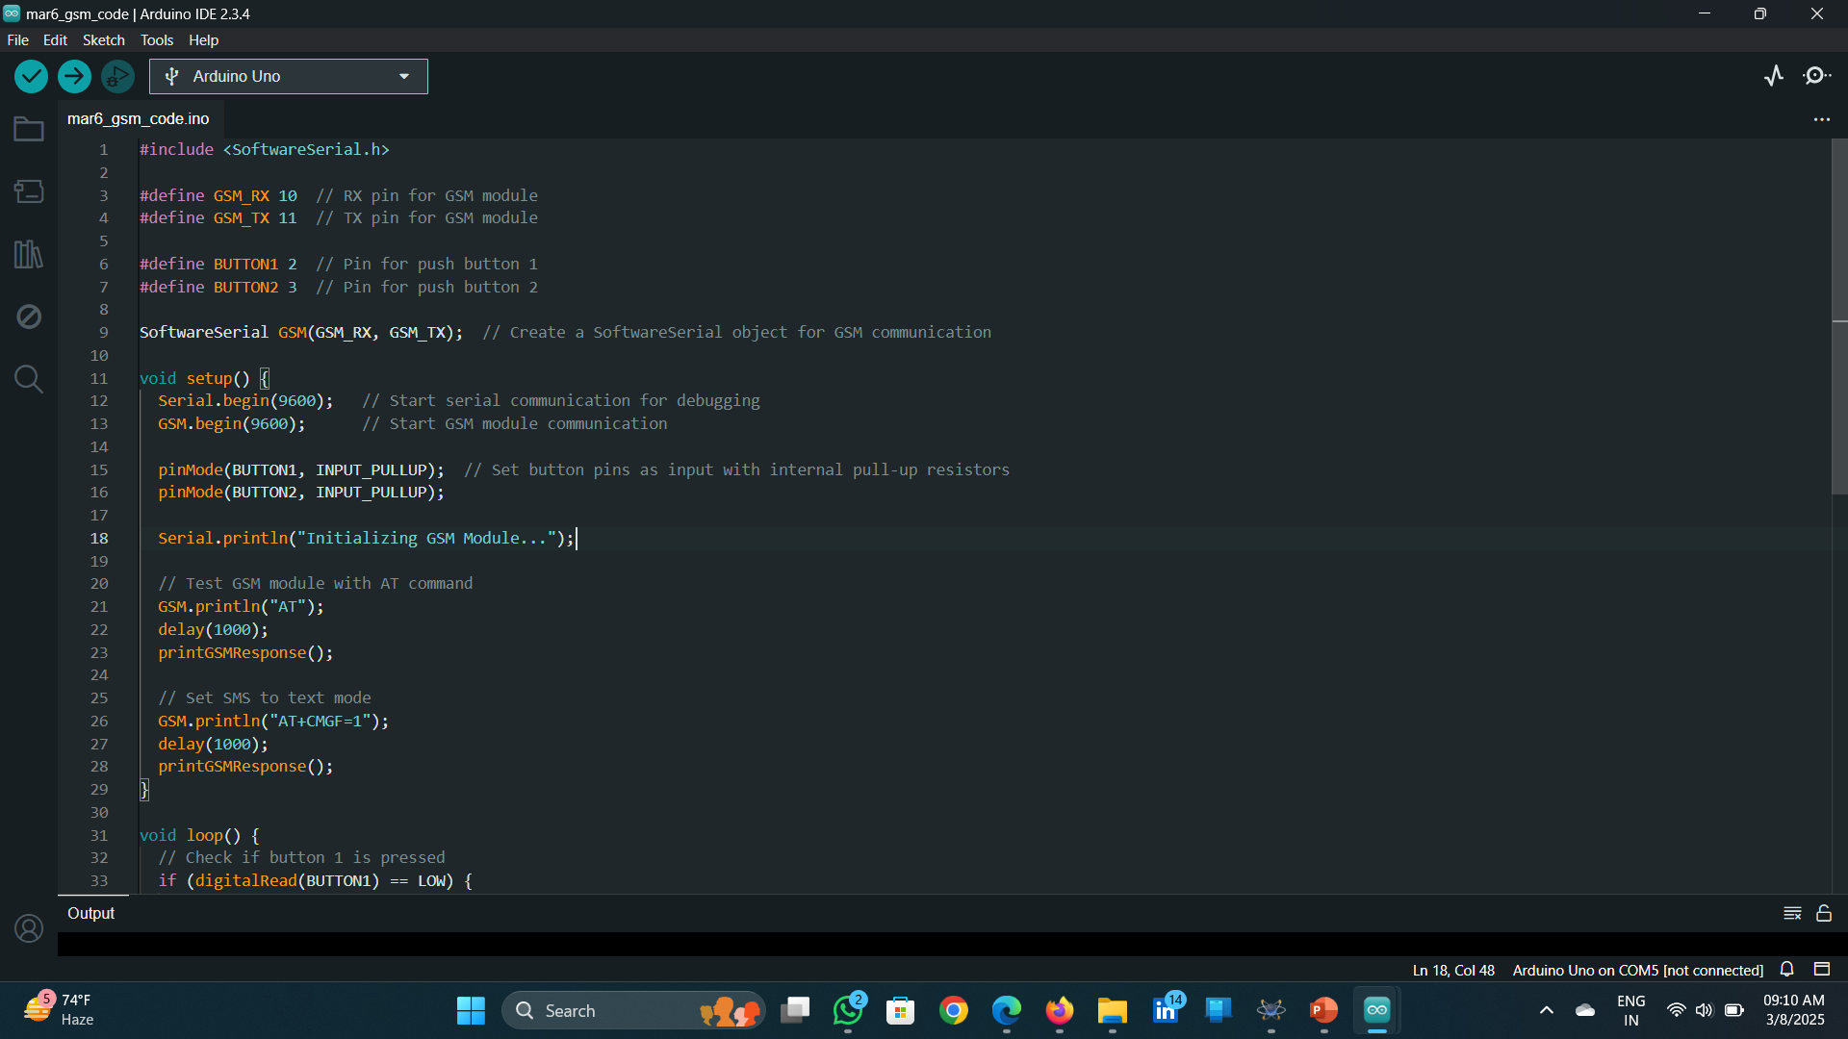

Slide 33
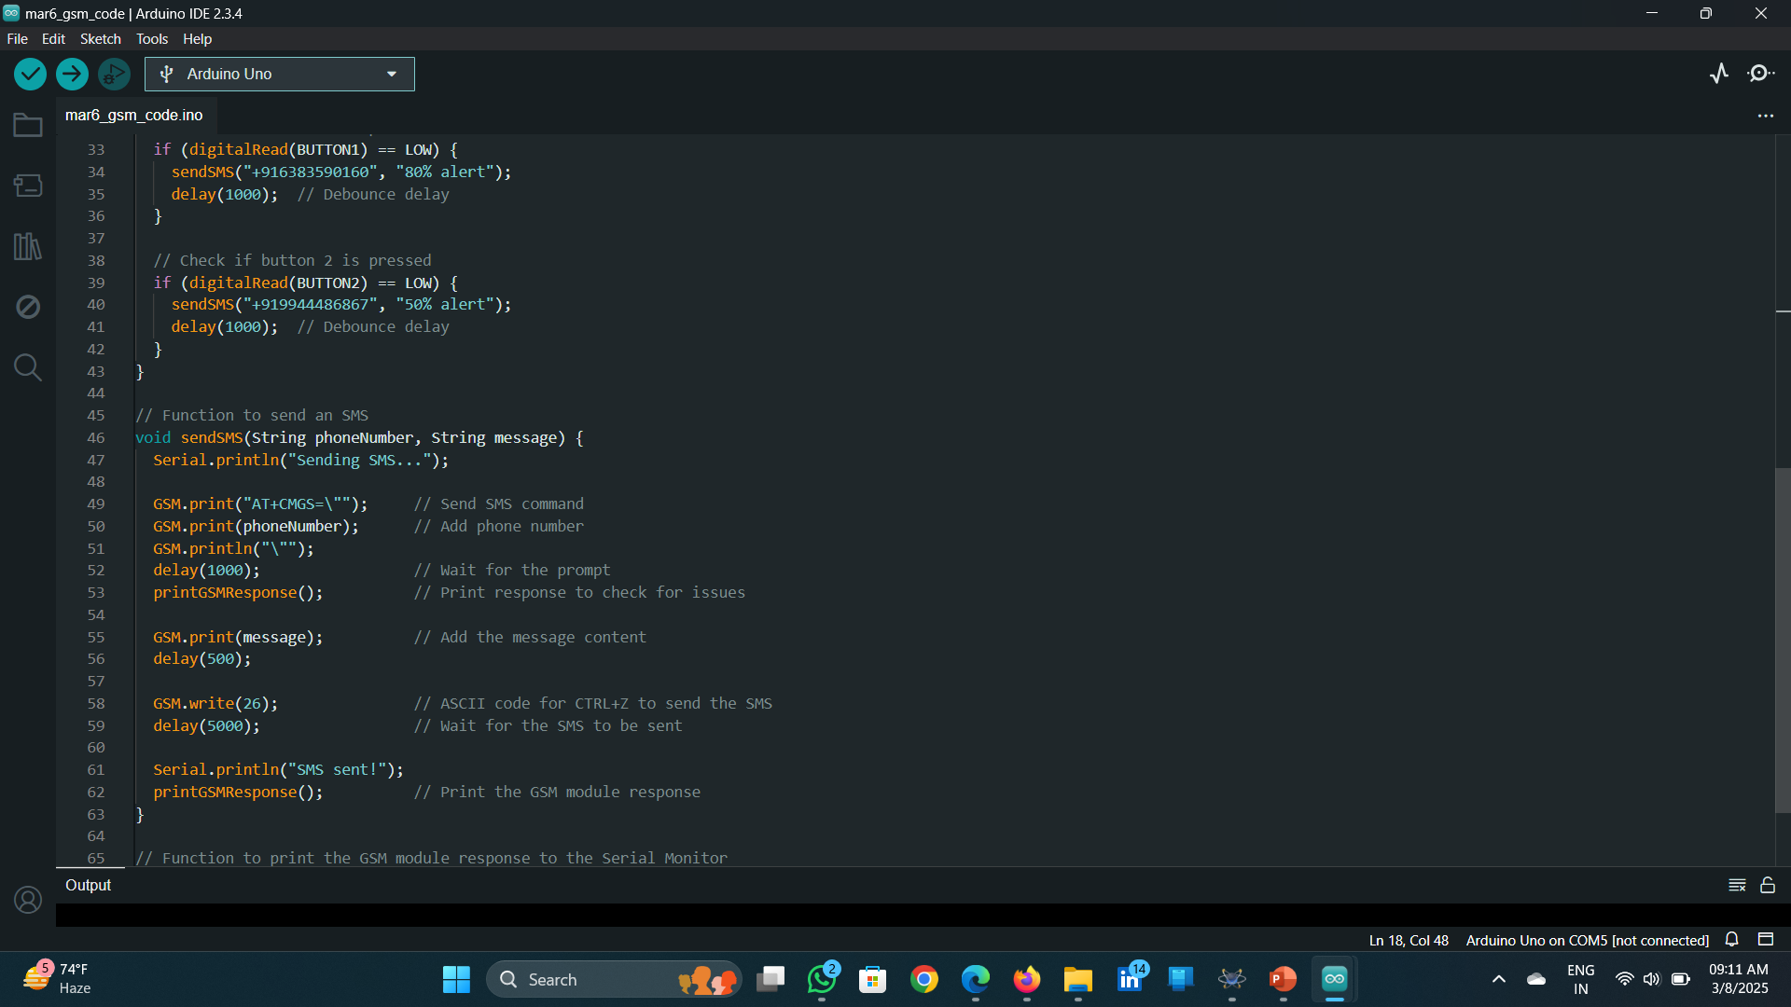

Slide 34
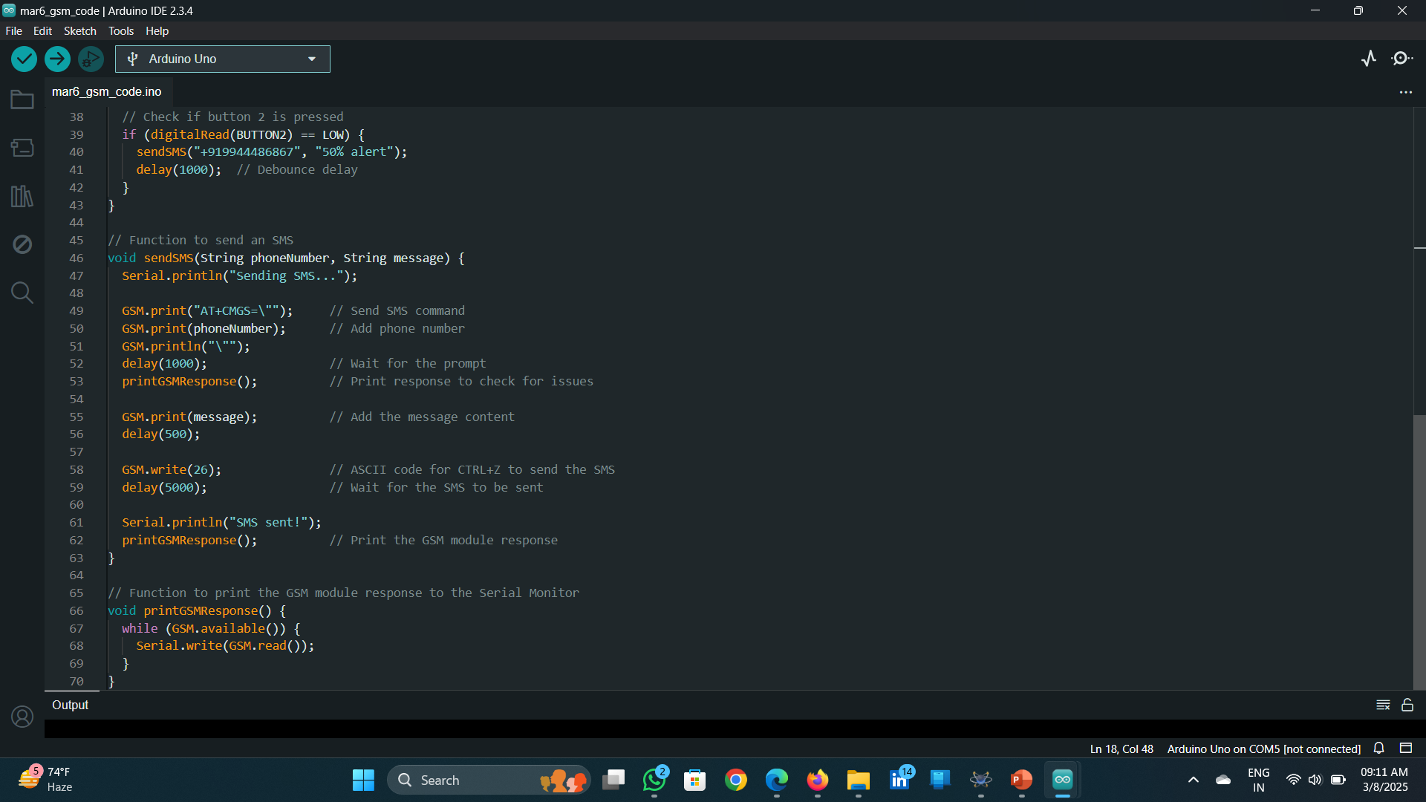

Slide 35
Webpage output:

Slide 36
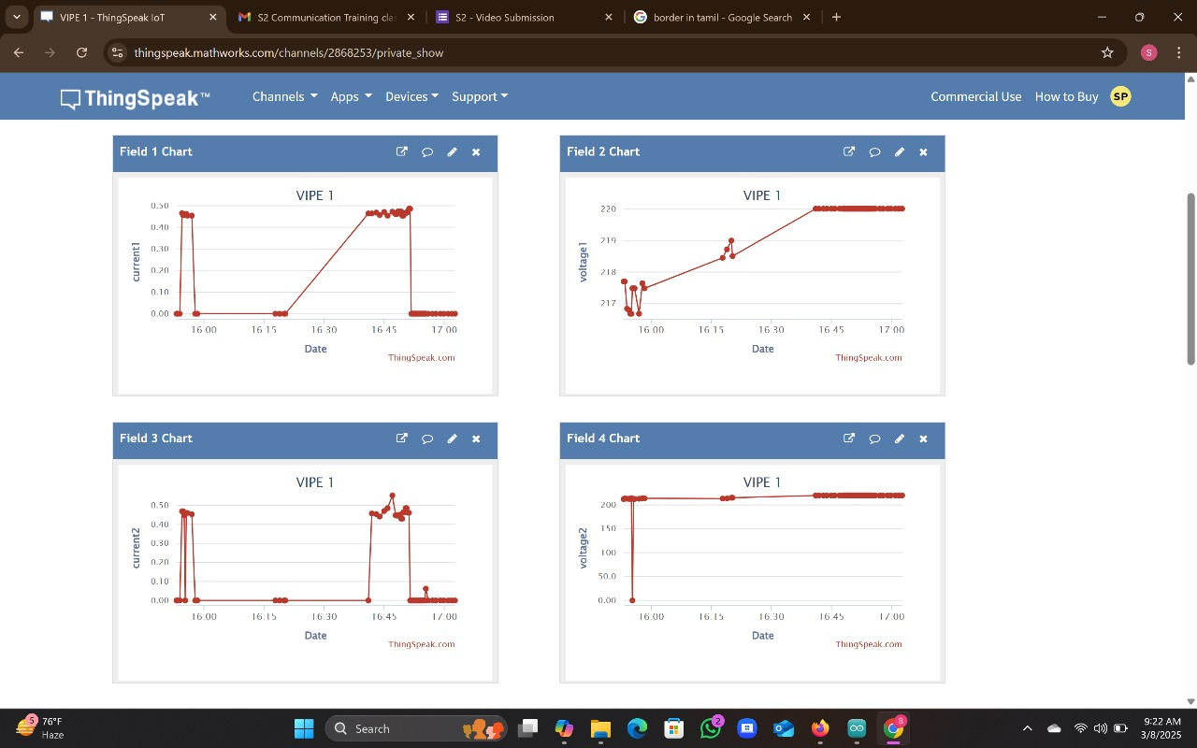

Slide 37
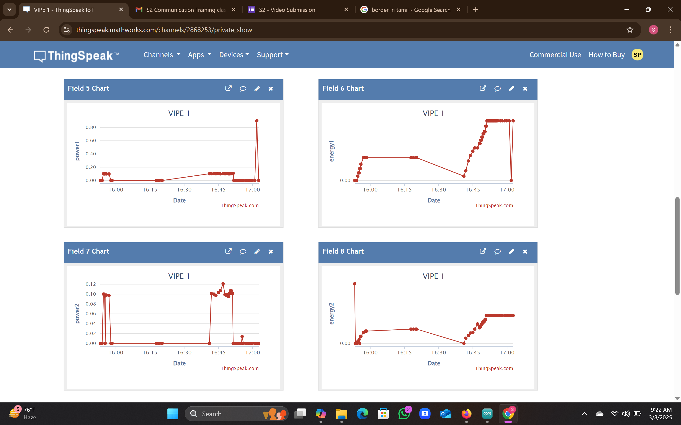

Slide 38
THANK YOU

